Slide 1

“ MACHINE LEARNING APPROACHES FOR IDENTIFYING NETWORK CYBER THREATS ”
GROUP 8
S.AKHILA (20S41A05A2)
T.MANISH REDDY (20S41A05A8)
MD.SAIFUDDIN (20S41A0577)
T.SHARANYA (20S41A05A7)
UNDER THE GUIDANCE OF
S.SATEESH REDDY
ASSOCIATE PROFESSOR

Slide 2

INDEX
1.ABSTRACT
2.EXISTING SYSTEM
3.DISADVANTAGES
4.PROPOSED SYSTEM
5.ADVANTAGES
6.SYSTEM ARCHITECTURE
7.SYSTEM REQUIREMENTS
8.MODULES
9.M0DULES DISCRIPTION
10.UML DIAGRAMS
11.SCREENSHOTS
12.CONCLUSION
13.REFERENCES

Slide 3
ABSTRACT
This project explores the application of machine learning techniques in the realm of cybersecurity, specifically focusing on the identification of network-based cyber threats. Leveraging advanced algorithms and data analysis, the research aims to enhance threat detection capabilities, providing a proactive defense mechanism against evolving cyber threats. The project not only seeks to enhance the accuracy and efficiency of threat detection but also addresses the challenges posed by the dynamic nature of cyber threats. This study contribute to the ongoing efforts in growing network security through intelligent and adaptive machine learning approaches. So it is all about using smart computer tricks to protect your computer from online bad stuff. The idea is to make your time online safer and smoother by using these cool machine learning tricks that learn and adapt to keep the cyber threats away.

Slide 4
EXISTING SYSTEM
The existing system for "Machine Learning Approaches for Identifying Network Cyber Threats" typically involves utilizing supervised and unsupervised learning techniques to analyze network traffic patterns.
These techniques are limited in their ability to detect new and evolving attacks and may generate positives or negatives.
The existing system follows old traditional methods to detect cyber attacks in network.

Slide 5
DISADVANTAGES
Strict Regulations
Difficult to work with for non-technical users
No Sufficient data storage
Constantly needs Patching
Constantly being attacked
Less accurate
Less efficiency

Slide 6
PROPOSED SYSTEM
The proposed system uses machine learning algorithms to analyze the network traffic patterns and detect duplicates or abnormal that may indicate a cyber attack.
The proposed system can also be enhanced with additional features such as real-time monitoring, automatic response mechanisms, and integration with other security system.
The proposing system is used to detect cyber attacks using machine learning methods to look after the limitations of existing system.
Real time monitoring is helpful to detect cyber attacks occured and automatic response is used to reduce the severity of the damage done by attacks.
Integration with other security systems, such as firewalls and intrusion detection systems, can improve overall network security and improves the effectiveness of the proposed system.

Slide 7
ADVANTAGES
Protection from malicious attacks on your network.
Deletion and/or guaranteeing malicious elements within a preexisting network.
Prevents users from unauthorized access to the network.
Deny's programs from certain resources that could be infected.
Securing confidential information
More efficient
High accuracy

Slide 8
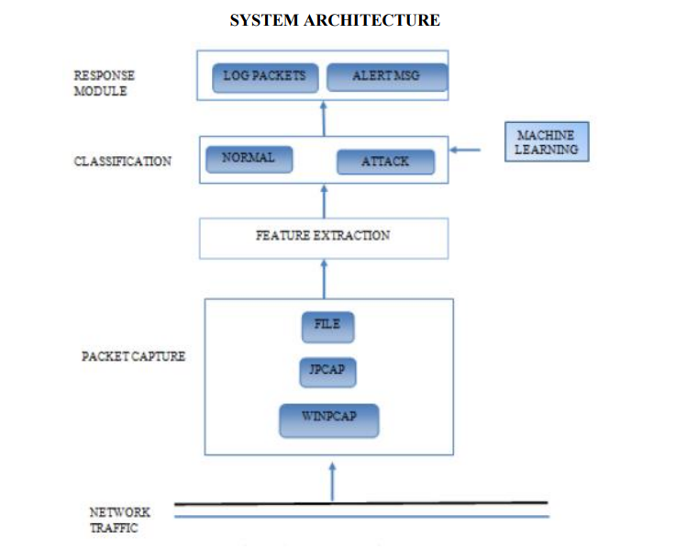

Slide 9
SOFTWARE REQUIREMENTS
OPERATING SYSTEM : WINDOWS 10
LANGUAGE : PYTHON 3.7
HARDWARE REQUIREMENTS
PROCESSOR : MINIMUM INTEL i3
RAM : MINIMUN 4gb
HARD DISK : MINIMUM 250gb

Slide 10
MODULES
This project consists of 4 modules
1. DATA COLLECTION
2. DATA PRE-PROCESSING
3. FEATURE EXTRATION
4. EVALUATION MODEL

Slide 11
MODULE DISCRIPTION
1. DATA COLLECTION
Data used in this paper is a set of product reviews collected from credit card transactions records. This step is concerned with selecting the subset of all available data that you will be working with. ML problems start with data preferably, lots of data (examples or observations) for which you already know the target answer. Data for which you already know the target answer is called labelled data.

Slide 12
2. DATA PRE-PROCESSING
Organize your selected data by formatting, cleaning and sampling from it. Three common data pre-processing steps are: Formatting: The data you have selected may not be in a format that is suitable for you to work with. The data may be in a relational database and you would like it in a flat file, or the data may be in a proprietary file format and you would like it in a relational database or a text file. Cleaning: Cleaning data is the removal or fixing of missing data. There may be data instances that are incomplete and do not carry the data you believe you need to address the problem. These instances may need to be removed. Additionally, there may be sensitive information in some of the attributes and these attributes may need to be removed from the data entirely. Sampling: There may be far more selected data available than you need to work with. More data can result in much longer running times for algorithms and larger computational and memory requirements. 23 You can take a smaller representative sample of the selected data that may be much faster for exploring and prototyping solutions before considering the whole dataset.
3. FEATURE EXTRATION
Next thing is to do Feature extraction is an attribute reduction process. Unlike feature selection, which ranks the existing attributes according to their predictive significance, feature extraction actually transforms the attributes. The transformed attributes, or features, are linear combinations of the original attributes. Finally, our models are trained using Classifier algorithm. We use classify module on Natural Language Toolkit library on Python. We use the labelled dataset gathered. The rest of our labelled data will be used to evaluate the models. Some machine learning algorithms were used to classify pre-processed data. The chosen classifiers were Random forest. These algorithms are very popular in text classification tasks.

Slide 13
4. Evaluation Model
Model Evaluation is an integral part of the model development process. It helps to find the best model that represents our data and how well the chosen model will work in the future. Evaluating model performance with the data used for training is not acceptable in data science because it can easily generate overoptimistic and over fitted models. There are two methods of evaluating models in data science, Hold-Out and Cross-Validation. To avoid over fitting, both methods use a test set (not seen by the model) to evaluate model performance. Performance of each classification model is estimated base on its averaged. The result will be in the visualized form. Representation of classified data in the form of graphs. Accuracy is defined as the percentage of correct predictions for the test data. It can be calculated easily by dividing the number of correct predictions by the number of total predictions

Slide 14
UML DIAGRAMS
The System Design Document describes the system requirements, operating environment, system and subsystem architecture, files and database design, input formats, output layouts, human-machine interfaces, detailed design, processing logic, and external interfaces.

Slide 15
USE CASE DIAGRAM:
A use case diagram in the Unified Modeling Language (UML) is a type of behavioral diagram defined by and created from a Use-case analysis. Its purpose is to present a graphical overview of the functionality provided by a system in terms of actors, their goals (represented as use cases), and any dependencies between those use cases. The main purpose of a use case diagram is to show what system functions are performed for which actor. Roles of the actors in the system can be depicted.

Slide 16
Start
Localhost
Register & Login to Application
Real Time Malware Detection
Data Stores in SQL
User
User Add Data
Attack Classification based on
model
Detection of Attack
Visualisation
End

Slide 17
CLASS DIAGRAM :
In software engineering, a class diagram in the Unified Modeling Language (UML) is a type of static structure diagram that describes the structure of a system by showing the system's classes, their attributes, operations (or methods), and the relationships among the classes. It explains which class contains information.

Slide 18
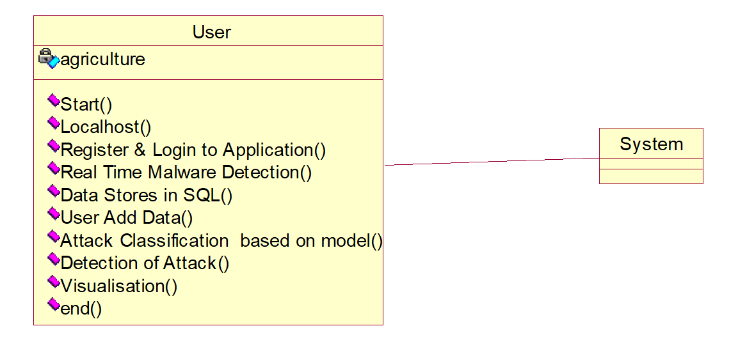

Slide 19
SEQUENCE DIAGRAM :
A sequence diagram in Unified Modeling Language (UML) is a kind of interaction diagram that shows how processes operate with one another and in what order. It is a construct of a Message Sequence Chart. Sequence diagrams are sometimes called event diagrams, event scenarios, and timing diagrams.

Slide 20
User
System
Start
Localhost
Register & Login to Application
Real Time Malware Detection
Data Stores in SQL
User Add Data
Attack Classification based on model
Detection of Attack
Visualisation

Slide 21
COLLABORATION DIAGRAM :
The collaboration diagram in UML is used to show the relationship between the objects in a system. Both the sequence and the collaboration diagrams represent the same information but differently. Instead of showing the flow of messages, it depicts the architecture of the object residing in the system as it is based on object-oriented programming. An object consists of several features. Multiple objects present in the system are connected to each other. The collaboration diagram, which is also known as a communication diagram, is used to portray the object's architecture in the system.

Slide 23
DEPLOYMENT DIAGRAM :
The deployment diagram visualizes the physical hardware on which the software will be deployed. It portrays the static deployment view of a system. It involves the nodes and their relationships.It ascertains how software is deployed on the hardware. It maps the software architecture created in design to the physical system architecture, where the software will be executed as a node. Since it involves many nodes, the relationship is shown by utilizing communication paths.

Slide 25
COMPONENT DIAGRAM :
A component diagram is used to break down a large object-oriented system into the smaller components, so as to make them more manageable. It models the physical view of a system such as executables, files, libraries, etc. that resides within the node.It visualizes the relationships as well as the organization between the components present in the system. It helps in forming an executable system. A component is a single unit of the system, which is replaceable and executable. The implementation details of a component are hidden, and it necessitates an interface to execute a function. It is like a black box whose behavior is explained by the provided and required interfaces.

Slide 27
ACTIVITY DIAGRAM :
In UML, the activity diagram is used to demonstrate the flow of control within the system rather than the implementation. It models the concurrent and sequential activities.The activity diagram helps in envisioning the workflow from one activity to another. It put emphasis on the condition of flow and the order in which it occurs. The flow can be sequential, branched, or concurrent, and to deal with such kinds of flows, the activity diagram has come up with a fork, join, etc.It is also termed as an object-oriented flowchart.It encompasses activities composed of a set of actions or operations that are applied to model the behavioral diagram.

Slide 29
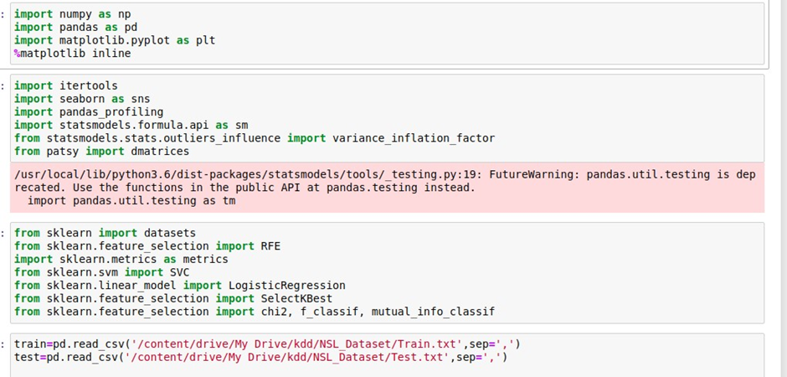
SCREEN SHOTS
Test Results: All the test cases mentioned above passed successfully. No defects encountered.
OUTPUT SCREENS

Slide 30
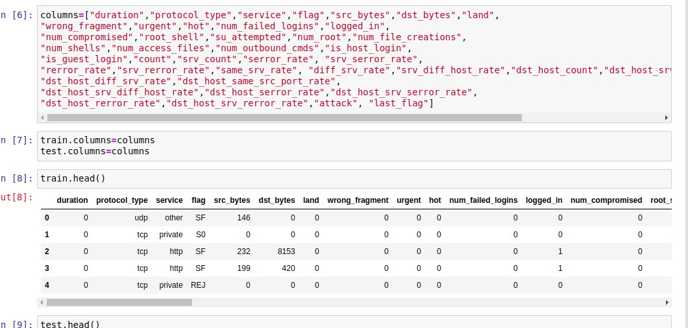
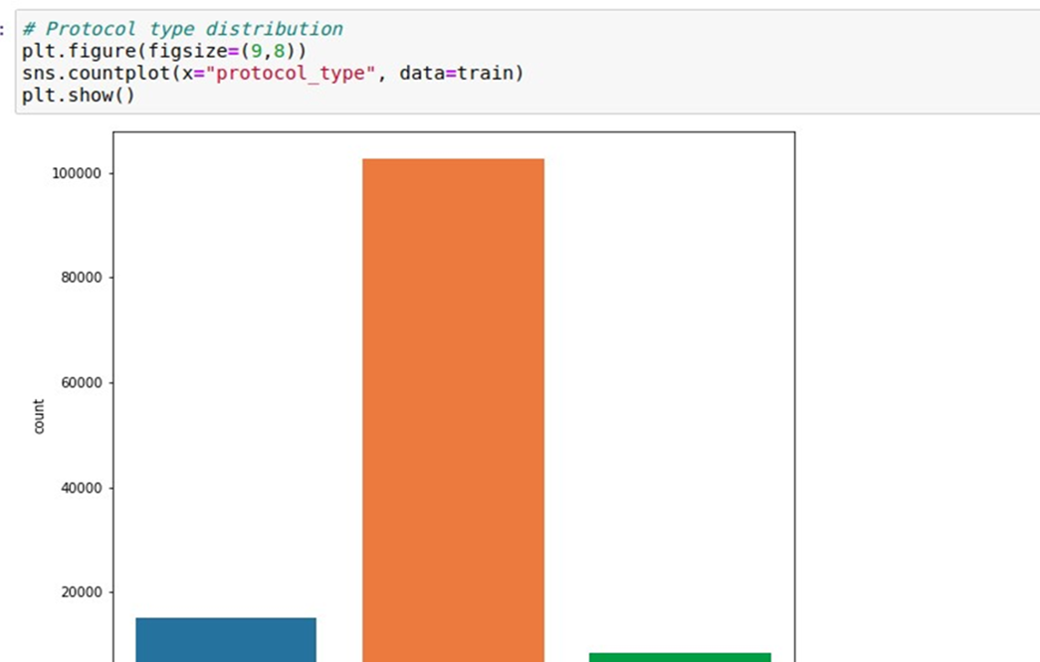
Data preprocessing
Data EDA

Slide 31
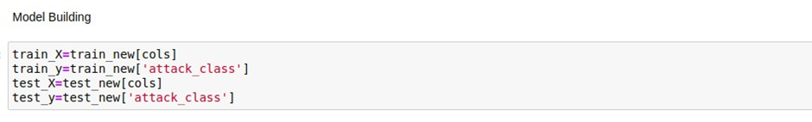
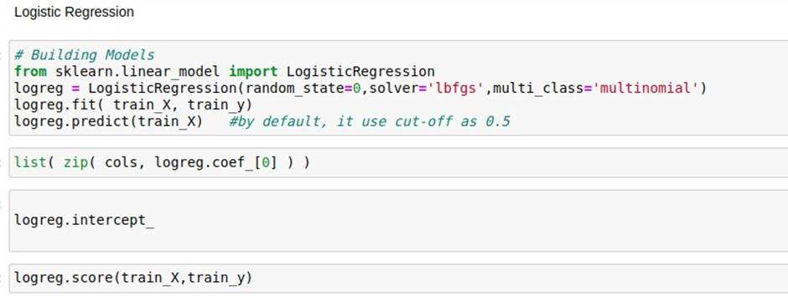
ML Deploy

Slide 32
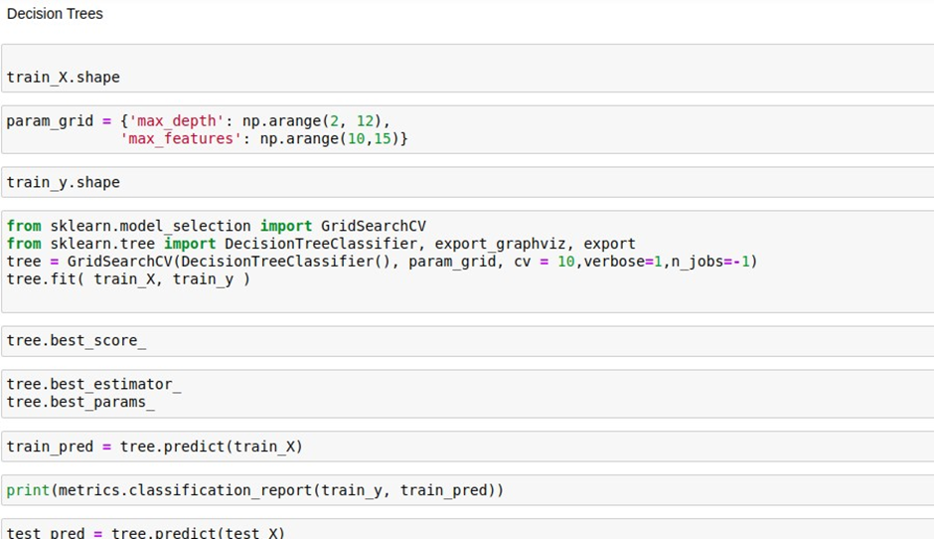
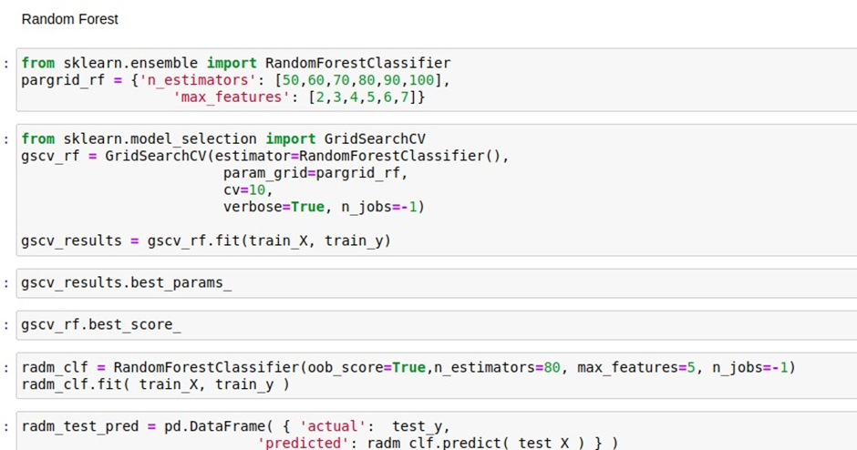

Slide 33
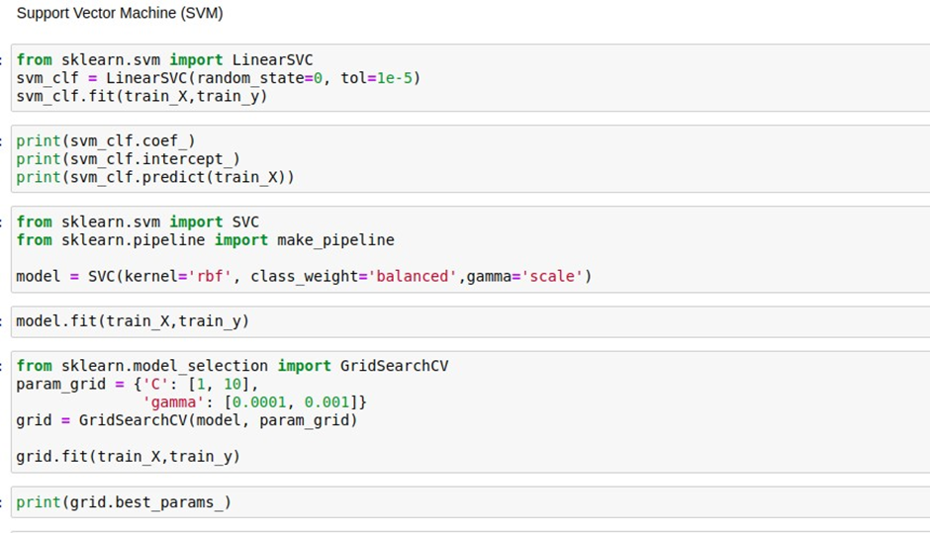
From the score accuracy we concluding the DT & RF give better accuracy and building pickle file for predicting the user input

Slide 34
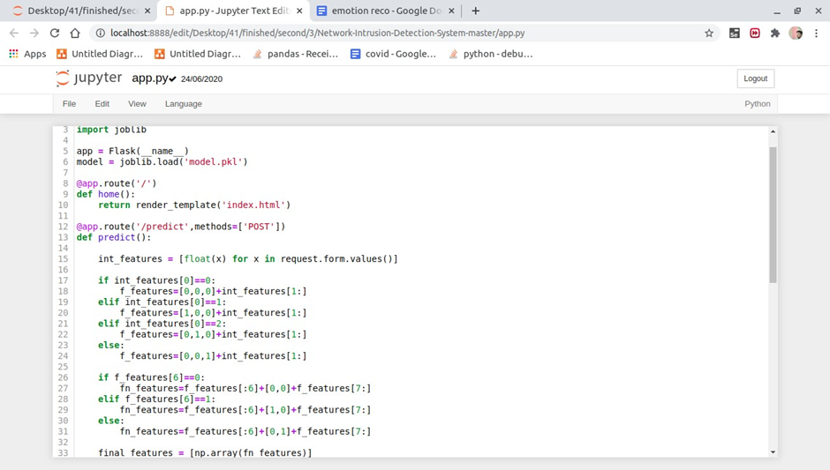
Application

Slide 35
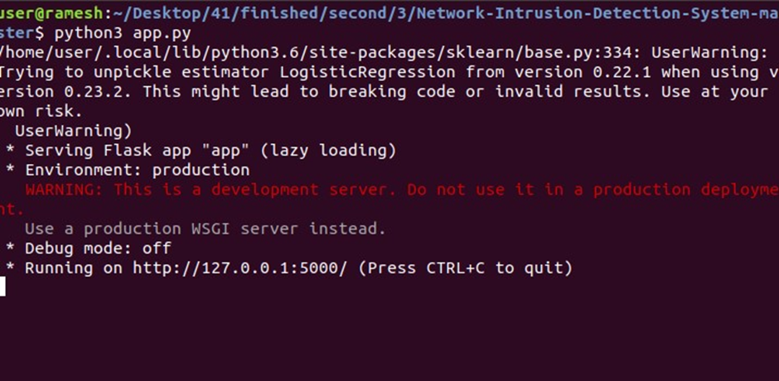
Localhost - in cmd python app.py

Slide 36
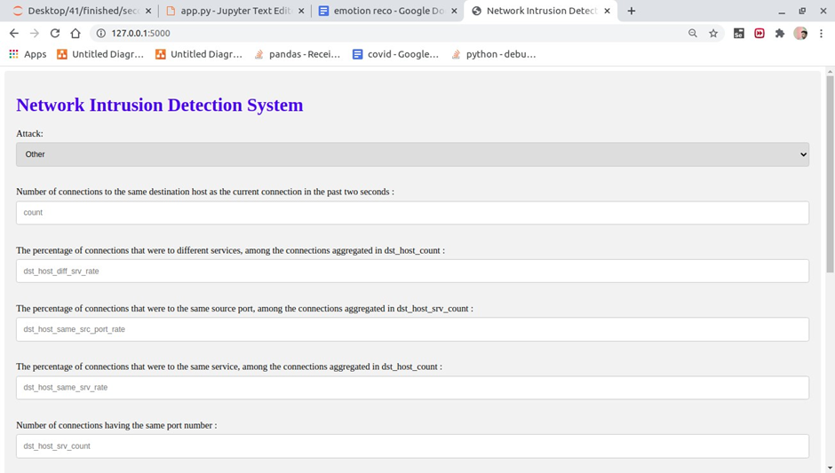

Slide 37
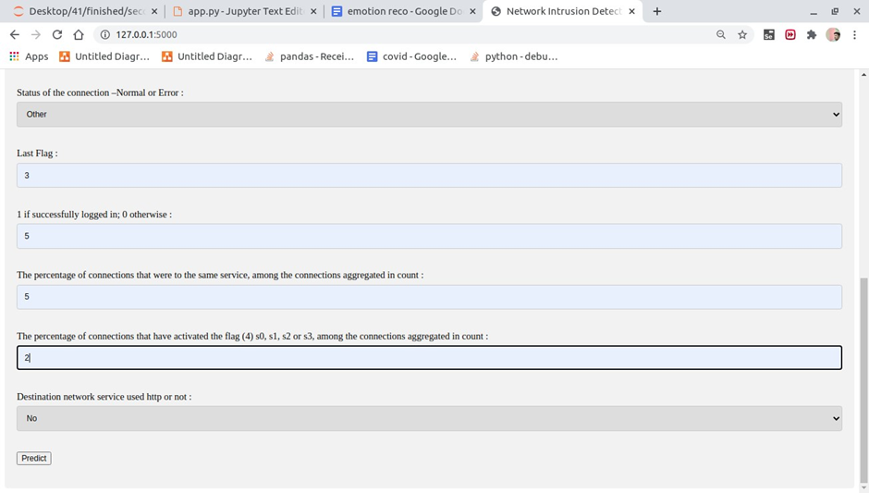
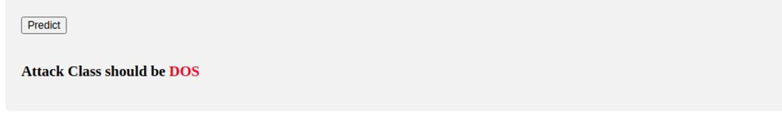
Enter the input
Predict attack -

Slide 38
CONCLUSION
Right now, estimations of help vector machine, ANN, CNN, Random Forest and profound learning calculations dependent on modern CICIDS2017 dataset were introduced relatively. Results show that the profound learning calculation performed fundamentally preferable outcomes over SVM, ANN, RF and CNN. We are going to utilize port sweep endeavors as well as other assault types with AI and profound learning calculations, apache Hadoop and sparkle innovations together dependent on this dataset later on. All these calculation helps us to detect the cyber attack in network. It happens in the way that when we consider long back years there may be so many attacks happened so when these attacks are recognized then the features at which values these attacks are happening will be stored in some datasets. So by using these datasets we are going to predict whether cyber attack is done or not. These predictions can be done by four algorithms like SVM, ANN, RF, CNN this paper helps to identify which algorithm predicts the best accuracy rates which helps to predict best results to identify the cyber attacks happened or not. In enhancement we will add some ML Algorithms to increase accuracy.

Slide 39
REFERENCES
1. K. Graves, Ceh: Official certified ethical hacker review guide: Exam 312-50. John Wiley & Sons, 2007.
2. R. Christopher, “Port scanning techniques and the defense against them,” SANS Institute, 2001.
3. M. Baykara, R. Das¸, and I. Karado ˘gan, “Bilgi g ¨uvenli ˘gi sistemlerinde kullanilan arac¸larin incelenmesi,” in 1st International Symposium on Digital Forensics and Security (ISDFS13), 2013, pp. 231–239.
4. S. Staniford, J. A. Hoagland, and J. M. McAlerney, “Practical automated detection of stealthy portscans,” Journal of Computer Security, vol. 10, no. 1-2, pp. 105–136, 2002.
5. S. Robertson, E. V. Siegel, M. Miller, and S. J. Stolfo, “Surveillance detection in high bandwidth environments,” in DARPA Information Survivability Conference and Exposition, 2003. Proceedings, vol. 1. IEEE, 2003, pp. 130–138.
6. K. Ibrahimi and M. Ouaddane, “Management of intrusion detection systems based-kdd99: Analysis with lda and pca,” in Wireless Networks and Mobile Communications (WINCOM), 2017 International Conference on. IEEE, 2017, pp. 1–6.
7. N. Moustafa and J. Slay, “The significant features of the unsw-nb15 and the kdd99 data sets for network intrusion detection systems,” in Building Analysis Datasets and Gathering Experience Returns for Security (BADGERS), 2015 4th International Workshop on. IEEE, 2015, pp. 25–31.
8. L. Sun, T. Anthony, H. Z. Xia, J. Chen, X. Huang, and Y. Zhang, “Detection and classification of malicious patterns in network traffic using benford’s law,” in Asia-Pacific Signal and Information Processing Association Annual Summit and Conference (APSIPA ASC), 2017. IEEE, 2017, pp. 864–872.
9. S. M. Almansob and S. S. Lomte, “Addressing challenges for intrusion detection system using naive bayes and pca algorithm,” in Convergence in Technology (I2CT), 2017 2nd International Conference for. IEEE, 2017, pp. 565–568.

Slide 40
THANK YOU

